Slide 1
Econ 106: Data Analysis for Economics Lecture 6 Fall 2024
slides adapted from https://stats.oarc.ucla.edu/r/seminars/ggplot2_intro/

Slide 2
Reminders
Lab 1 is due Sunday, 11:59pm (Q3 was updated)
https://pollev.com/vsovero

Slide 3
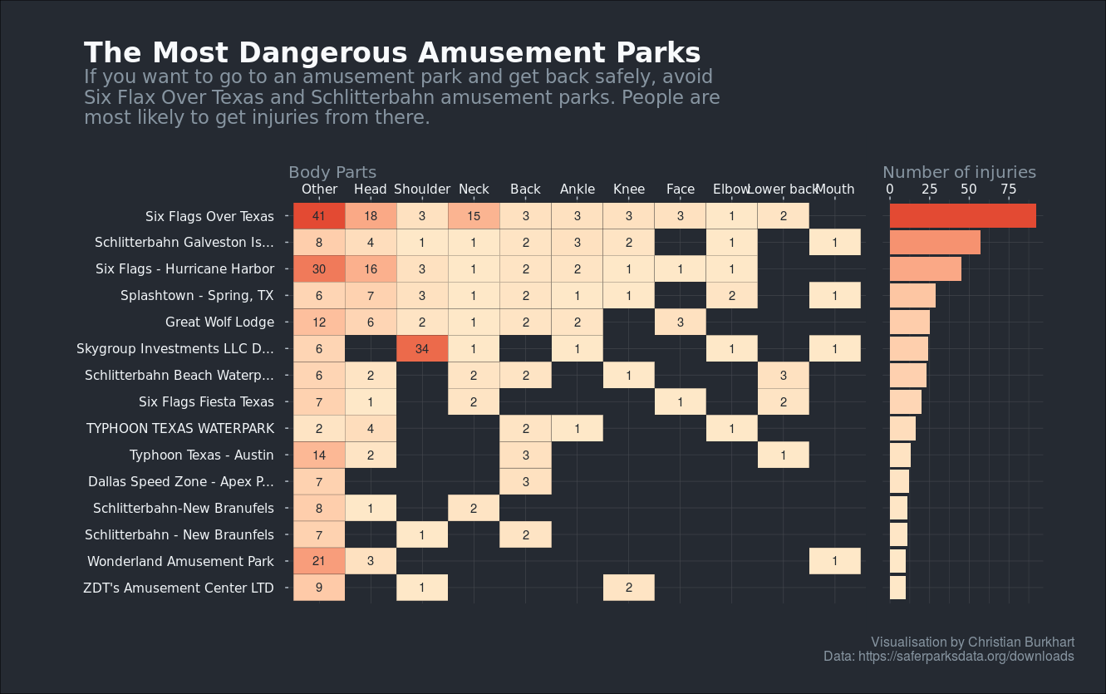
#tidytuesday
https://x.com/ChBurkhart/status/1173646158339727361?s=20

Slide 4
Outline
Color setting vs mapping
Bar graphs
Notes:
In brief, we’ll
1. Introduce the R programming language and the RStudio interface
2. Discuss how operators and functions work
3. Investigate the structure of data frames

Slide 5
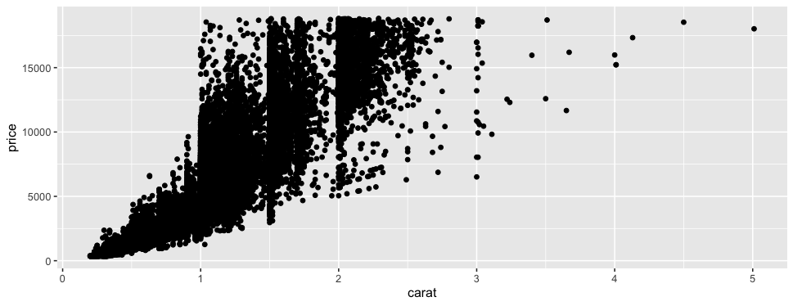
Basic Elements of ggplot
ggplot(data = diamonds,
mapping = aes(x = carat, y = price)) +
geom_point()
Data: the data you want to plot
Layout: mapping variables on the plot
Data display: how you want the data to be visualized (points, lines, bars, etc.)
Notes:
However, the data are not plotted on the graph until you specify the geom. Make sure to add the + operator at the end of the ggplot statement. In this case, we’ll be plotting the data as points using geom_point()
Let’s see how this works
Demo 2:
· gray plot area
ggplot(data = surveys_complete)
· Axes drawn
ggplot(data = surveys_complete,
aes(x = weight,
y = hindfoot_length))
Plot ggplot(data = surveys_complete, aes(x = weight,
– axes drawn
· scatter plot of hindfoot length vs weight
ggplot(data = surveys_complete,
aes(x = weight,
y = hindfoot_length)) +
geom_point()

Slide 6
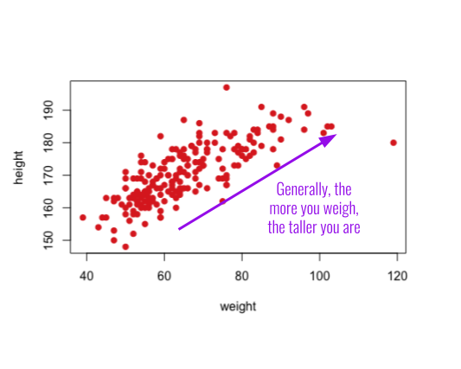
Scatter plots
Which geom? geom_point()
What type of data? Two numeric variables

Slide 7
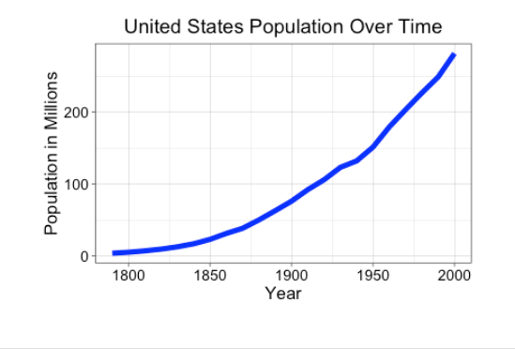
Line graphs
Which geom? geom_line()
What type of data? a date/time variable and a numeric variable
https://pollev.com/vsovero

Slide 8
Adjusting Plot Settings
color: color of 1-d objects
fill: fill color of 2-d objects
linetype: how lines should be drawn (solid, dashed, dotted, etc.)
shape: shape of markers in scatter plots
size: how large objects appear
alpha: transparency of objects (value between 0 and 1)

Slide 9
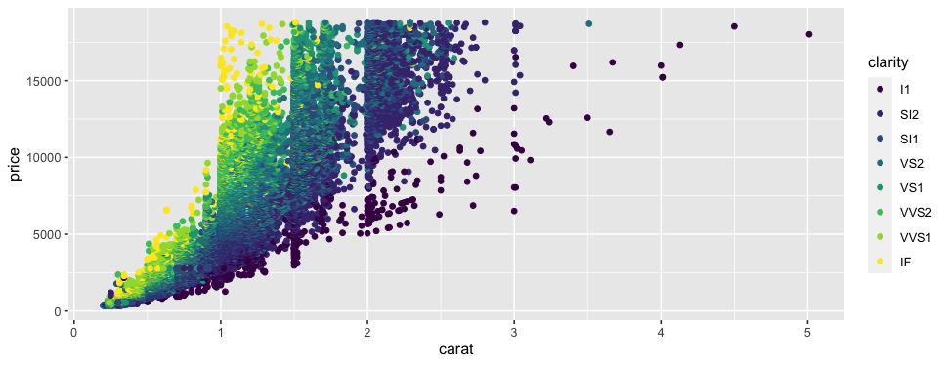
Color Mapping
ggplot(data = diamonds,
mapping= aes(x = carat, y = price)) +
geom_point(aes(color = clarity))
Color points by clarity
Input: color = categorical variable
Remember, anything that references variables in the dataset must be inside aes():
Output: a colored plot by clarity
Notes:
We can also use color to tell us something about the data. For example, we can colorize the points based on a factor variable, in this case species id. To do this, we can alter the aesthetics within geom_point with the argument color = species_id.
Demo 5:
· Copy and Paste Demo 3
· Change color = blue to aes(color = species_id)
· Need to use aes because it’s referencing the data frame instead of one color

Slide 10
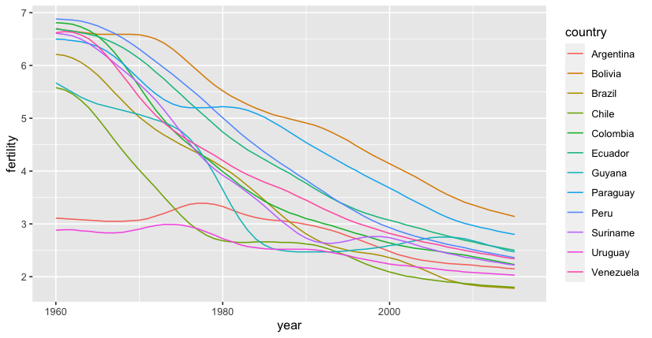
Color Mapping (line graph)
gapminder %>%
filter(region=="South America") %>%
ggplot(mapping=aes(x=year, y=fertility)) +
geom_line(aes(color=country))
when we use the color argument for a line graph, it will:
create a separate line for each country
assign each country a unique color

Slide 11
Color: Setting vs. Mapping
Color Setting: color is a fixed value
Set aesthetics to a constant outside the aes() function.
Color Mapping: color will vary based on the value of a variable
Map aesthetics to variables inside the aes() function

Slide 12
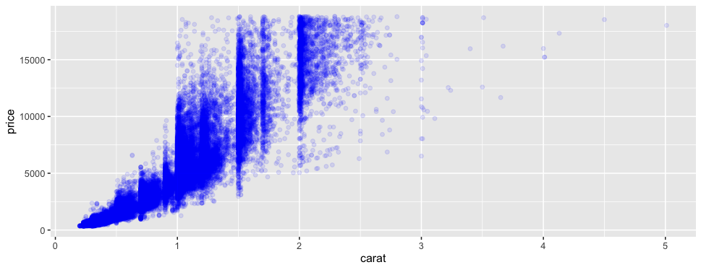
Setting vs. Mapping
https://pollev.com/vsovero
The color is set to blue (color setting):
Color is mapped to the clarity variable (color mapping):
ggplot(data = diamonds,
mapping= aes(x = carat, y = price))+
geom_point(color = "blue")
ggplot(data = diamonds,
mapping= aes(x = carat, y = price))+
geom_point(aes( color = clarity))

Slide 13
Exercise
use the jobs_gender data frame to create a scatter plot of total_earnings on the x-axis and wage_percent_of_male on the y-axis, color mapping by major_category

Slide 14
Aesthetic Mappings
Quantitative and Categorical variables work for:
color and fill: color gradient scales or evenly-spaced hue scales
Only categorical variables work for:
shape
linetype
Your code will run, but you really should only use quantitative variables for:
size
alpha

Slide 15
Exercise
make a scatter plot of:
total_earnings on the x-axis and wage_percent_of_male on the y-axis
map total_employees to size
alpha of .2

Slide 16
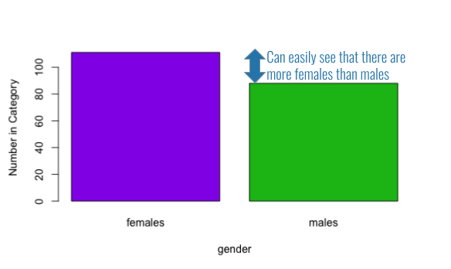
Bar plot
Counting frequencies of a single categorical variable

Slide 17
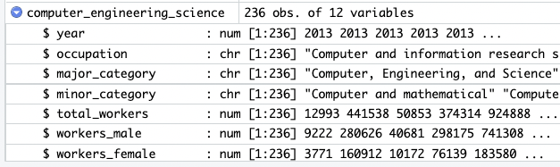
Bar plot (frequency counts are in the data)
computer_engineering_science <- jobs_gender %>%
filter(major_category=="Computer, Engineering, and Science")

Slide 18
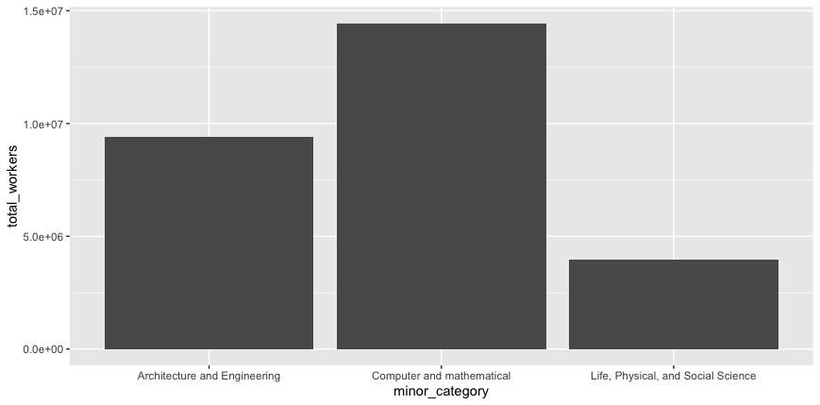
Bar plot (frequency counts are in the data)
ggplot(data = computer_engineering_science,
mapping=aes(x=minor_category, y=total_workers))+
geom_col()
geom_col() is adding up the total workers for each value of minor_category

Slide 19
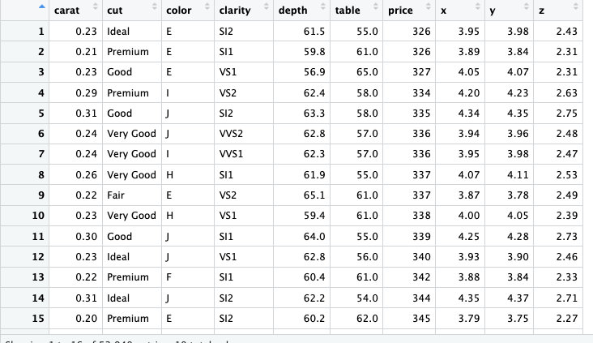
Bar plot (counts are not in the data)
in this dataset, there is no variable that counts the frequency of each cut
we have to ask ggplot to count for us

Slide 20
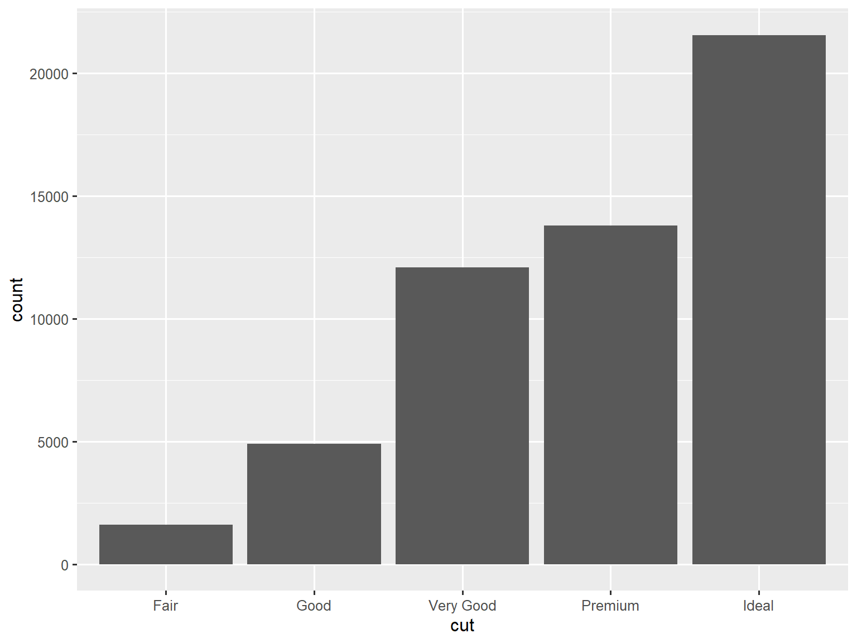
Bar plot (ggplot counts the frequencies)
ggplot(data = diamonds,
mapping=aes(x=cut))+
geom_bar()
https://pollev.com/vsovero

Slide 21
Data Example
https://github.com/rfordatascience/tidytuesday/tree/master/data/2019/2019-09-10
we will use the safer_parks data from this tidy Tuesday challenge (code to load the data is in the lecture script)

Slide 22
Exercise
create a bar graph that shows the frequency of each value of industry sector

Slide 23
Color Mapping with geom_bar()
How do we color map a bar plot?
Same idea as before- has to go within the aes() function
use fill option to color the entire bar

Slide 24
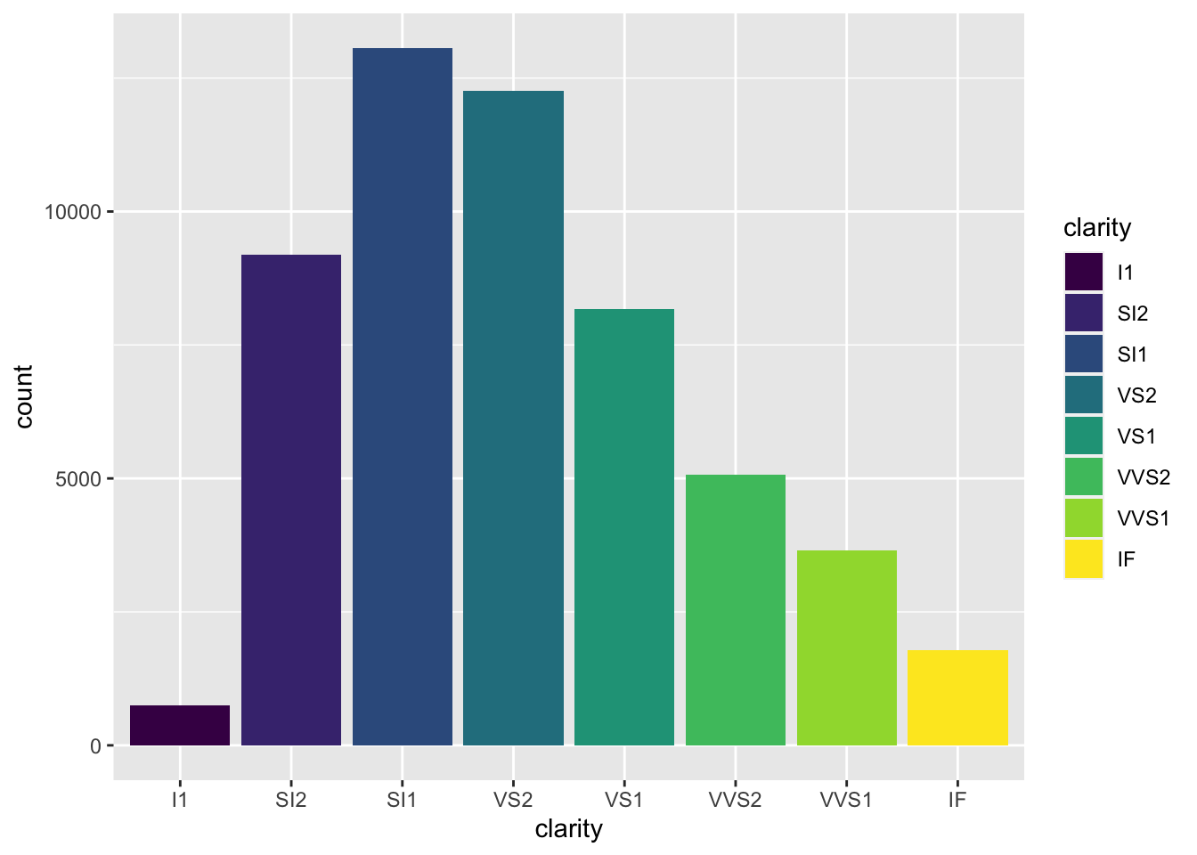
Color mapping with fill
ggplot(data=diamonds,
mapping= aes(x=clarity)) +
geom_bar(aes(fill=clarity))

Slide 25
Exercise
create a bar graph that shows the frequency of each value of industry sectors
color the bars by industry sector
https://pollev.com/vsovero

Slide 26
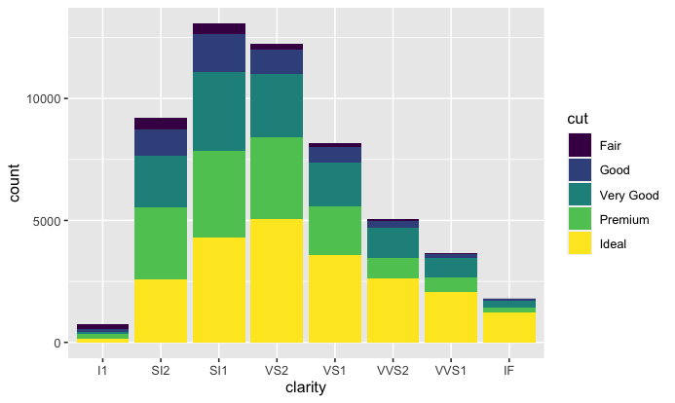
Stacked barplot (counts)
The counts of clarity are broken down further by cut
ggplot(data=diamonds,
mapping= aes(x=clarity)) +
geom_bar(aes(fill=cut))

Slide 27
Exercise
filter for amusement rides
only keep injury reports where the gender reported is male or female
create a bar graph that shows the frequencies of each value of device category
within each device category, show the gender counts

Slide 28
Exercise
filter for amusement rides
only keep injury reports where the gender reported is male or female
create a bar graph that shows the frequencies of each value gender
within each gender, show the device category counts

Slide 29
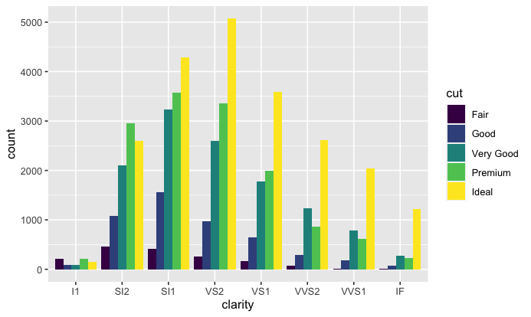
Grouped Bar plot (counts)
ggplot(data=diamonds,
mapping= aes(x=clarity)) +
geom_bar(aes(fill=cut), position="dodge")
the we use the dodge position to creates a separate bar for every combination of cut and clarity

Slide 30
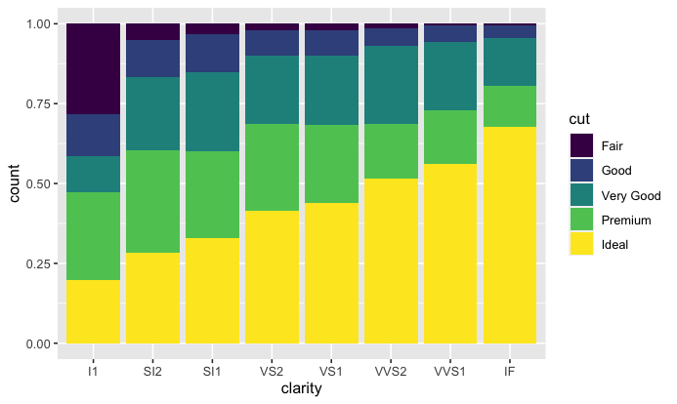
Stacked Bar plot (proportions)
we use the fill position to show proportions within each value of clarity
we can see that the proportion of ideal cut diamonds is greater for diamonds with higher clarity
ggplot(data=diamonds,
mapping= aes(x=clarity)) +
geom_bar(aes(fill=cut), position="fill")

Slide 31
Exercise
filter for amusement rides
only keep injury reports where the gender reported is male or female
create a bar graph that shows the frequencies of each value of device category
within each device category, show the gender proportions

Slide 32
Some parting words of wisdom
Things to be mindful of:
Know if your variables are quantitative or categorical
Know how your data is currently structured vs. how it needs to be structured for visualization (wrangle your data as needed)

Slide 33
Plan ahead
What type of data do I have?
What information do I want to convey?
What type of plot will visualize this information?
Notes:
Now that we’ve got an informative graph of species observations over the years, let’s get it publication ready.
· First, I’d remove the gray background and
· Make the axis labels more descriptive
· As well as increasing the font size
· We can do this using premade themes and the theme function

Slide 34
What plot do I need?
Data | Information | Plot
Two quantitative variables | Relationship between two variables | scatterplot
Quantitative variable and time | Trend over time | Line plot
Categorical variable | Frequencies within a single variable | barplot
Two categorical variables | Frequencies across variables | Grouped barplot
Two categorical variables | Relative frequencies across variables | Stacked barplot

Slide 35
What geom() do I need?
Plot | geom
scatterplot | geom_point()
Line plot | geom_line()
barplot | geom_bar() or geom_col()
Grouped barplot | geom_bar()
Stacked barplot | geom_bar()

